Slide 1
Lecture 17-18 Synchrotron
Yue Hao

Slide 2
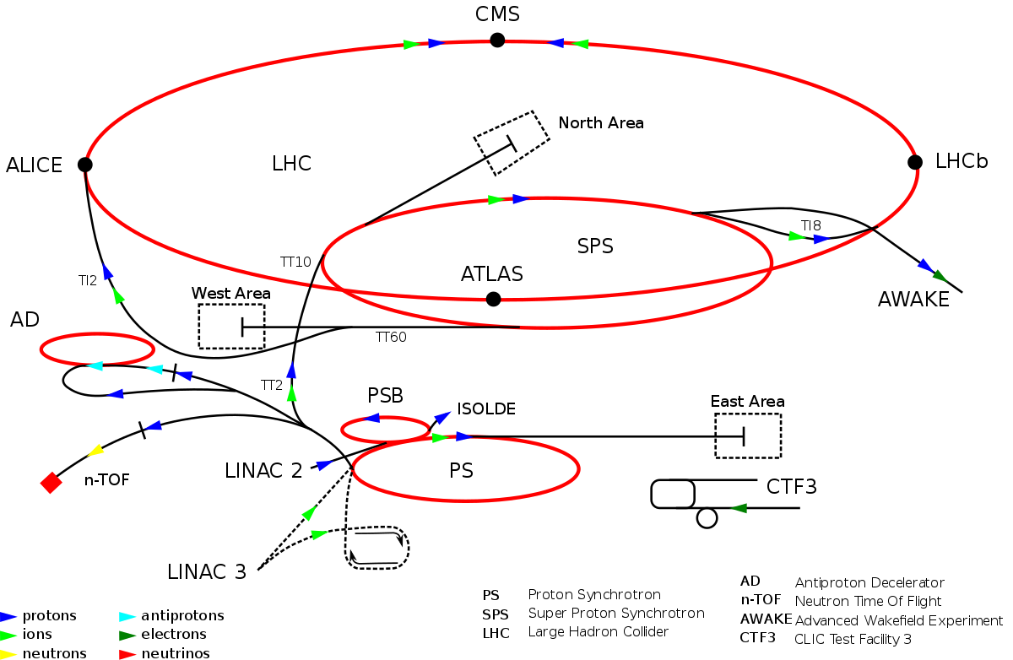
Example: LHC Accelerator Complex

Slide 3
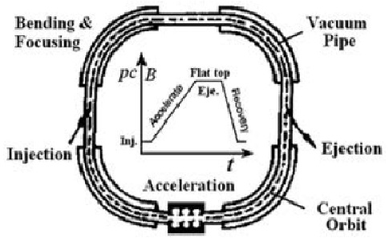
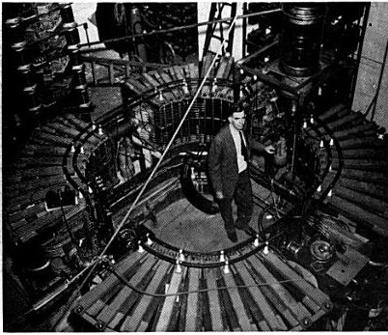
Why Synchrotron?
 | Magnetic Field | Frequency | Orbit
Cyclotron | Fixed | Change for relativistic particle. | Increase with ascending energy
Synchrotron | Vary | Keep Constant | Keep Constant
Angular frequency:
Achieve high energy in circular ring
First synchrotron

Slide 4
Outlines
Earlier synchrotrons
Principle of operation
Synchrotron motions
Injection
Extraction

Slide 5
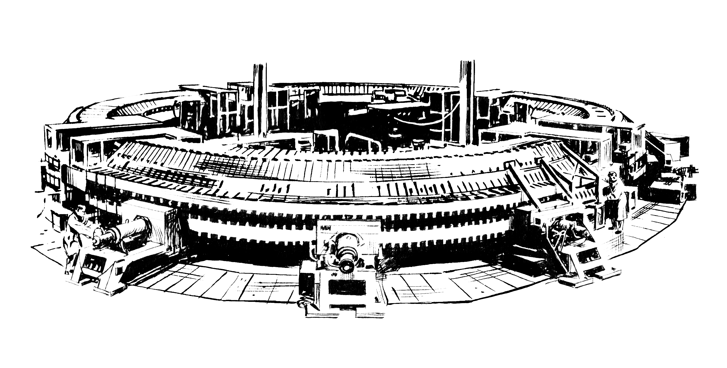
Earlier stage
Cosmotron at Brookhaven National Laboratory, 1948-1968, reach 3.3 GeV proton, Weak focusing accelerator.

Slide 6
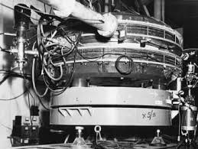
Earlier Stage
ADA collider at LNF in Frascati (1961-1964), reaches 250 MeV and achieve electron-position collision.

Slide 7
Operation principle
As the energy/momentum of the particle increases, the magnetic field is also ramped so that the following relation holds:
The angular frequency gives
Only in ultra-relativistic case, the orbit and frequency can be ‘synchronized’ together.

Slide 8
Energy Dynamic Range
There is no one accelerator to accelerate the particle from source all the way to the top energy (>GeV level)
Frequency changes a lot.
Space charge at low energy.
Linac handles up to ~MeV
One synchrotron can boost the energy up 10x-100x, from its injection energy to the top energy
Need accelerator complex to achieve high energy
Injection and Extraction are important.

Slide 9
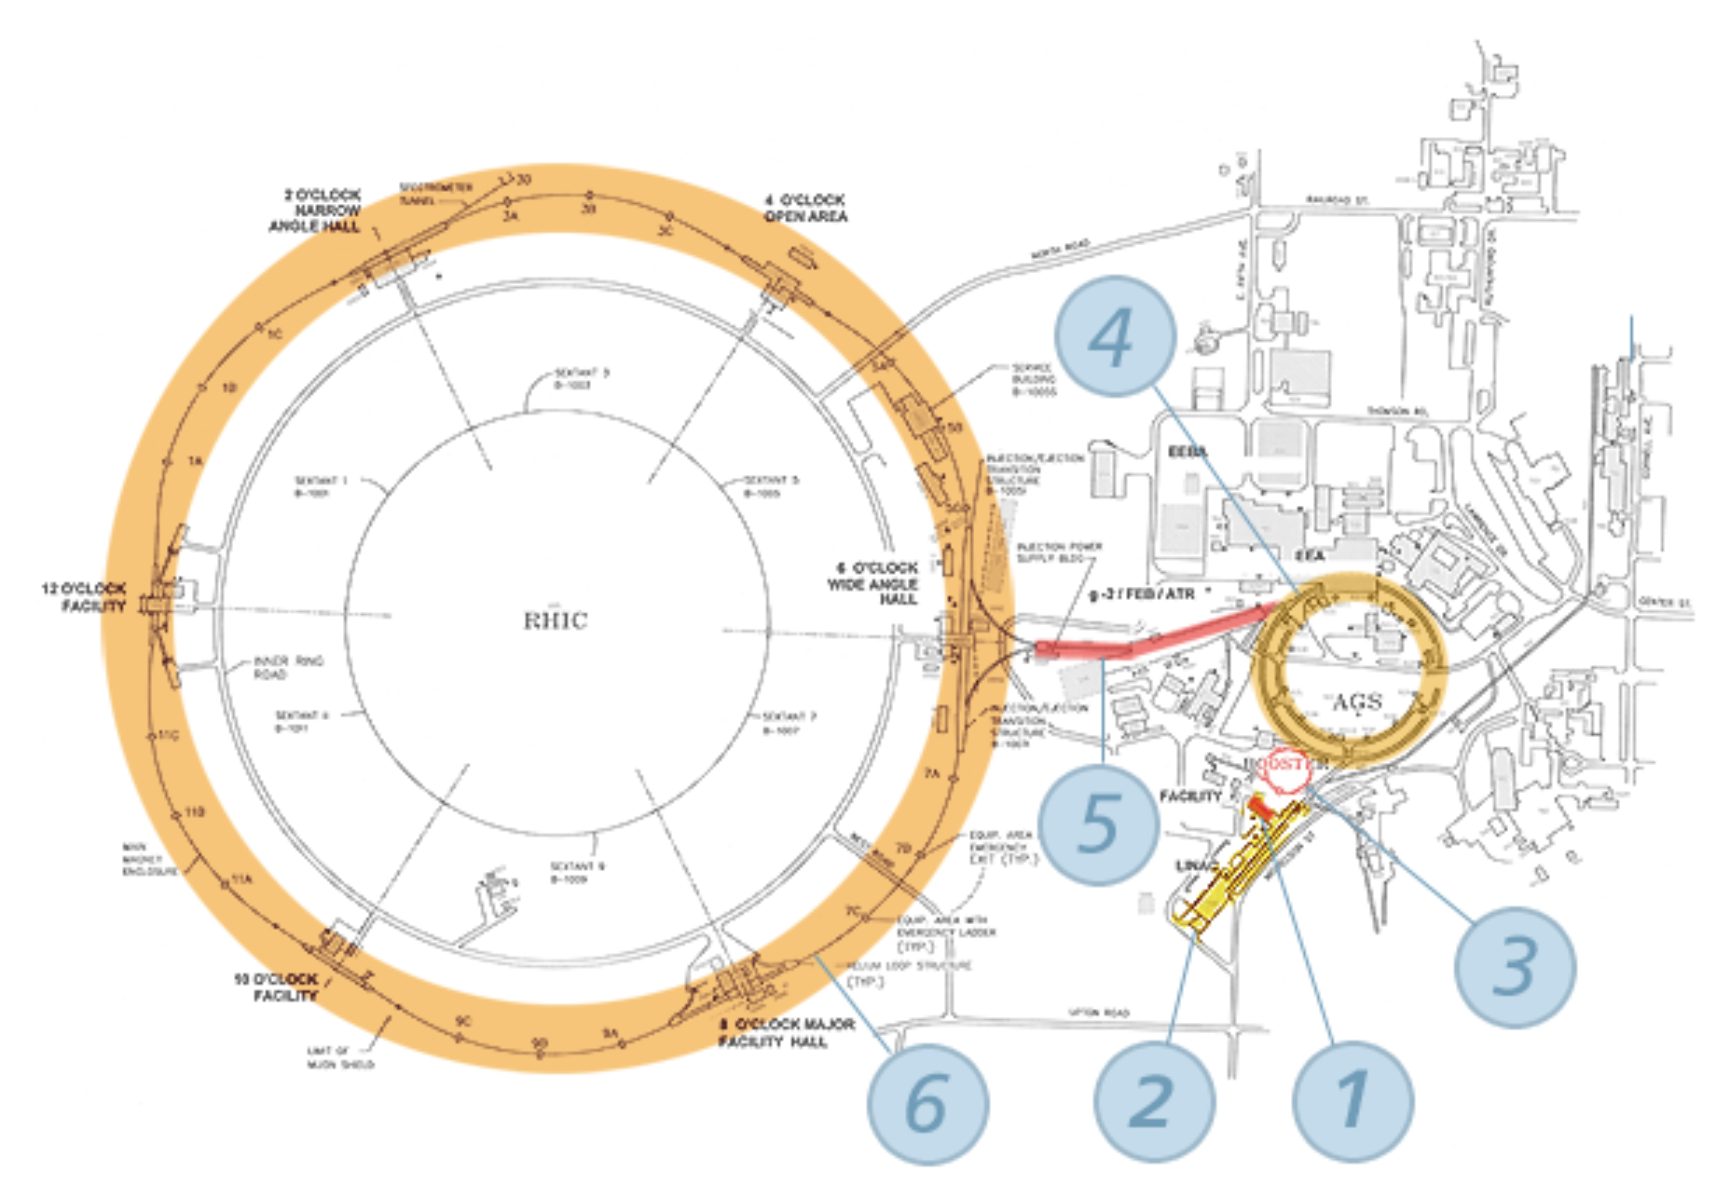
Accelerator complex
Relativistic Heavy Ion Collider complex:
1. EBIS (Electron Beam Ion Source); 2. Linac Accelerator
3. Booster 4. AGS (Alternating Gradient Synchrotron)
5. AGS to RHIC Line 6. RHIC

Slide 10
Synchronization

Slide 11
Synchrotrons in RHIC complex
Booster, from 200 MeV proton/ 2MeV ion to 100MeV/nucleon
Alternative Gradient Synchrotron, accelerate to ~9 GeV/ nucleon.

Slide 12
Synchrotrons in LHC complex
Proton Synchrotron (1.4 GeV to 25 GeV), 628m
Proton Synchrotron Booster (50MeV to 1.4 GeV)
Low Energy Ion Ring
Super Proton Synchrotron (25 GeV to 450 GeV), 7 km

Slide 13
Injection

Slide 14
Simple goals
Simple Goal: “Put beam in to synchrotron at its lowest energy (injection energy).”
To the zero’s order, it looks like the right figure.
More requirements:
Need to inject h particles, h>>1
The i^{th} injected bunch not affect 1…i-1 bunches
Need time-depend kicks

Slide 15
Bunch Filling

Slide 16
One-turn injection
The simplest scheme:

Slide 17
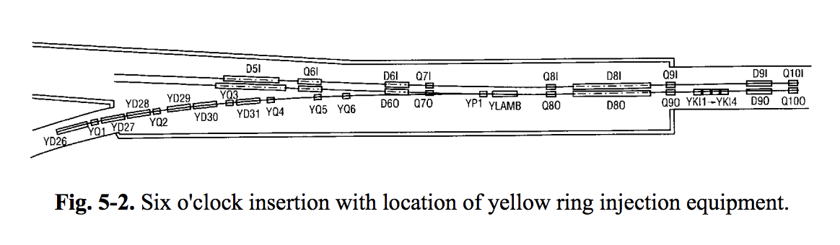
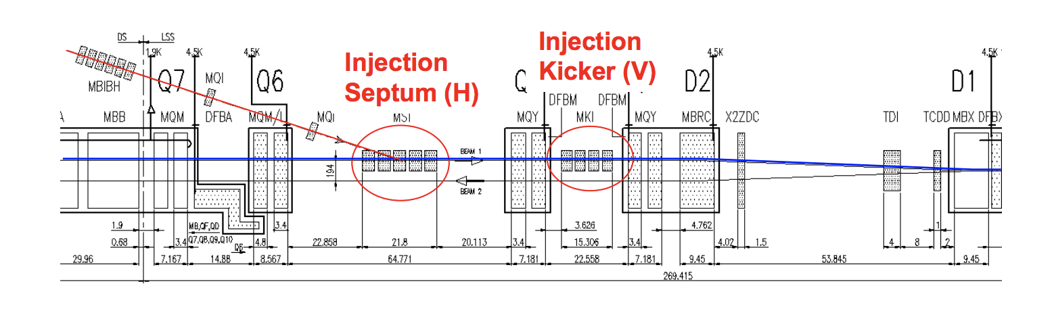
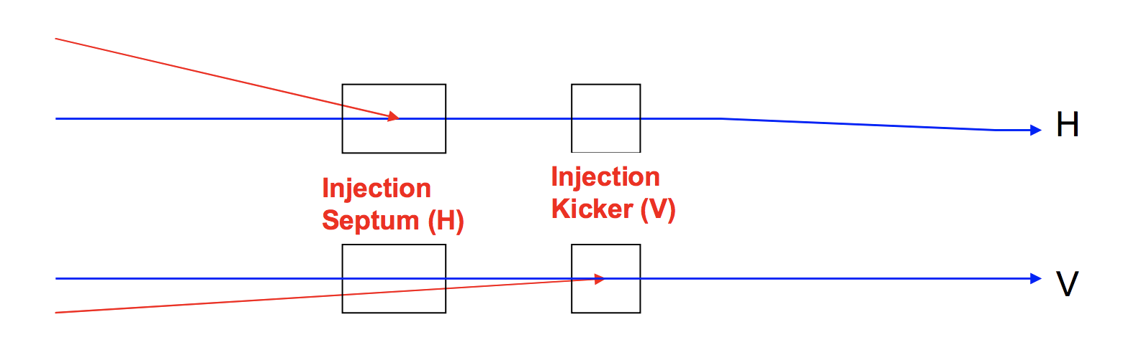
Real layouts
RHIC
LHC

Slide 18
Transfer Matrix
If we know the twiss parameter of both end and phase advance in between
S₁ represents the kicker.
S₀ represents the septum.

Slide 19
What happened in phase space
The injected bunch experience three necessary steps in phase space, which put the bunch exactly same location in phase space, as other circulating bunches.
The circulating bunch does not experience this due to
Spatial separation at septum magnet
Time separation at injection kicker.

Slide 20
Septum
Septum Coil
Yoke
Lambertson

Slide 21
Injection Kicker
RHIC Injection Kicker
Time for injecting the bunch

Slide 22
Injection Errors, Oscillations

Slide 23
Injection Error, Filamentation

Slide 24
Injection Error, Filamentation

Slide 25
Injection Error, Filamentation

Slide 26
Injection Error, Mismatch

Slide 27
Emittance Blowup
Both Injection angle/position error and mismatch cause emittance blowup
The Blowup is due to filamentation
Filamentation is due to the frequency spread of the particles
Nonlinearity
Chromatic effect
Have to correct both the injection orbit and optical mismatch to avoid emittance growth.

Slide 28
Multi-turn injection
Some times it is impossible to have high intensity one-turn injection
Limited by the intensity of previous accelerator or source
Limited from space charge effect
Solution: Multi-turn injection
Instead of one kicker, we need several fast dipole to create ‘bump’
These fast dipole create varying bump strength throughout the injection process
Well controlled transverse tune.
This is the process of ‘Painting in transverse phase space’

Slide 29
Multi-Turn Idea

Slide 30
Multi-turn Injection

Slide 31
Multi-turn Injection

Slide 32
Charge exchange H- Injection
Essential for low loss injection for high intensity beam.
May achieve ~0.02%
Without CEI, the best loss is 10%.

Slide 33
Extraction

Slide 34
Schemes
Treat extraction as reverse procedure of Injection (fast)
Single turn extraction
Multi-turn extraction (No resonance)
We can play more tricks with using nonlinear resonance
Nonlinear resonance slow extraction
Nonlinear low-loss extraction

Slide 35
Single Turn Extraction
@ Matthew Fraser, CERN ACC. School, 2017

Slide 36
Multi-Turn extraction (Non-resonance)

Slide 37
Multi-Turn extraction (Non-resonance)

Slide 38
Multi-turn extraction (Non-resonance)
This scheme will extract the beam within few turns.
Beam loss is an issue.
Septum need to be very thin.
It is hard to have same intensity, emittance, centroid for every part of the beam.
We can use nonlinear resonance to do a better job.

Slide 39
Resonance (slow) extraction
Very slow extraction
~1000 turns, perfect for low dose applications like medical applications
This example is third order resonance, when the tune is about 1/3 or 2/3
Still have loss at septum

Slide 40
Resonance Low Loss Extraction
Use sextrupole and Octupole to control the nonlinear island.
The beam is split into many, usually 4 equally populated island and then use septum wire to extract them.

Slide 41
More readings
Injection and extraction material are largely borrowed from:
http://cas.web.cern.ch/schools/erice-2017

